Slide 1

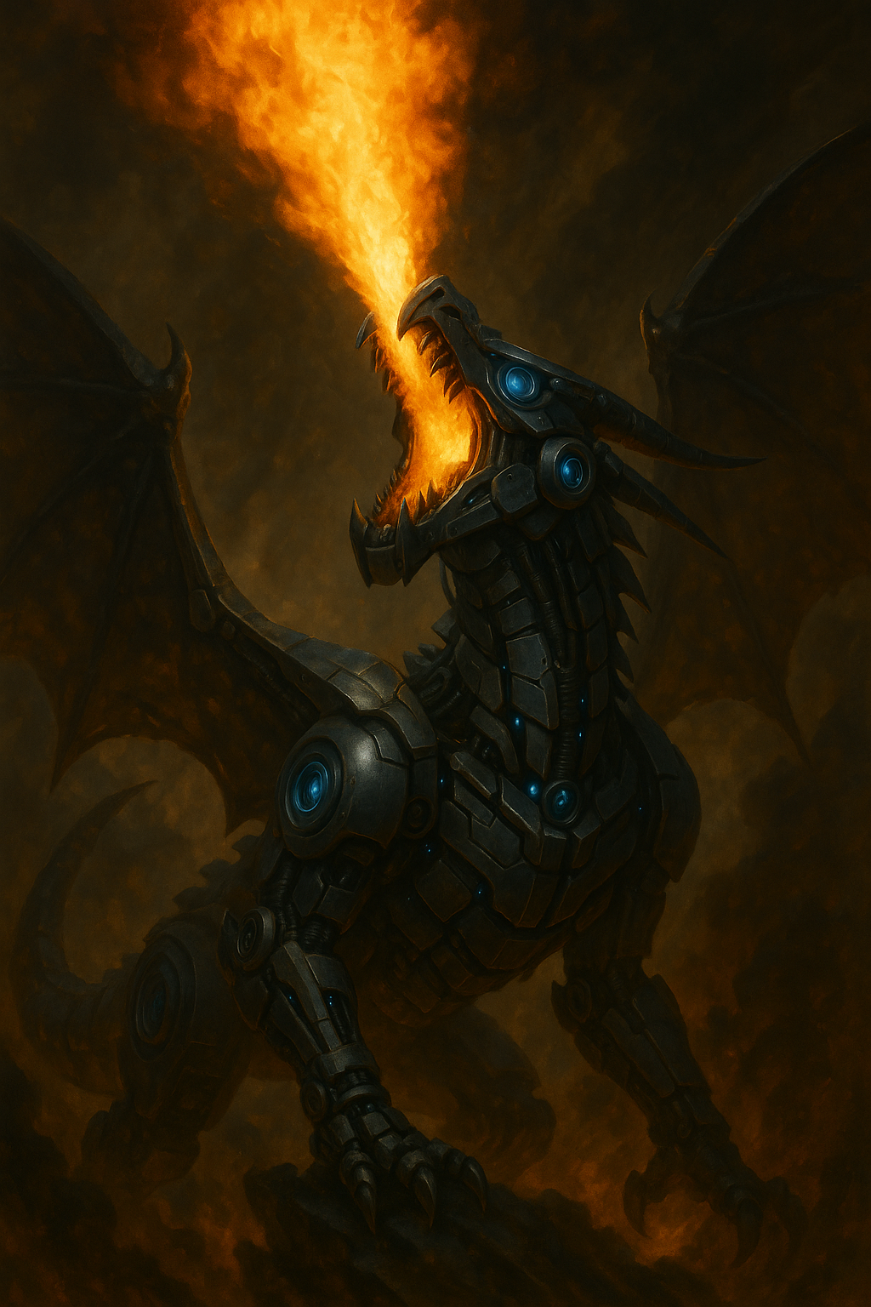
Software Craftsmanship for Coding Agents:
Taming the Dragon
Steven Diamante
Technical Coach & AI Consultant Founder of Diamante Technical Coaching

Slide 2
This talk is for software engineers
Thinking about using coding agents
Using agents for side projects only
Using agents in production, but struggling
Using agents successfully, want to hear how others do it
Notes:
Law of 2 feet

Slide 3
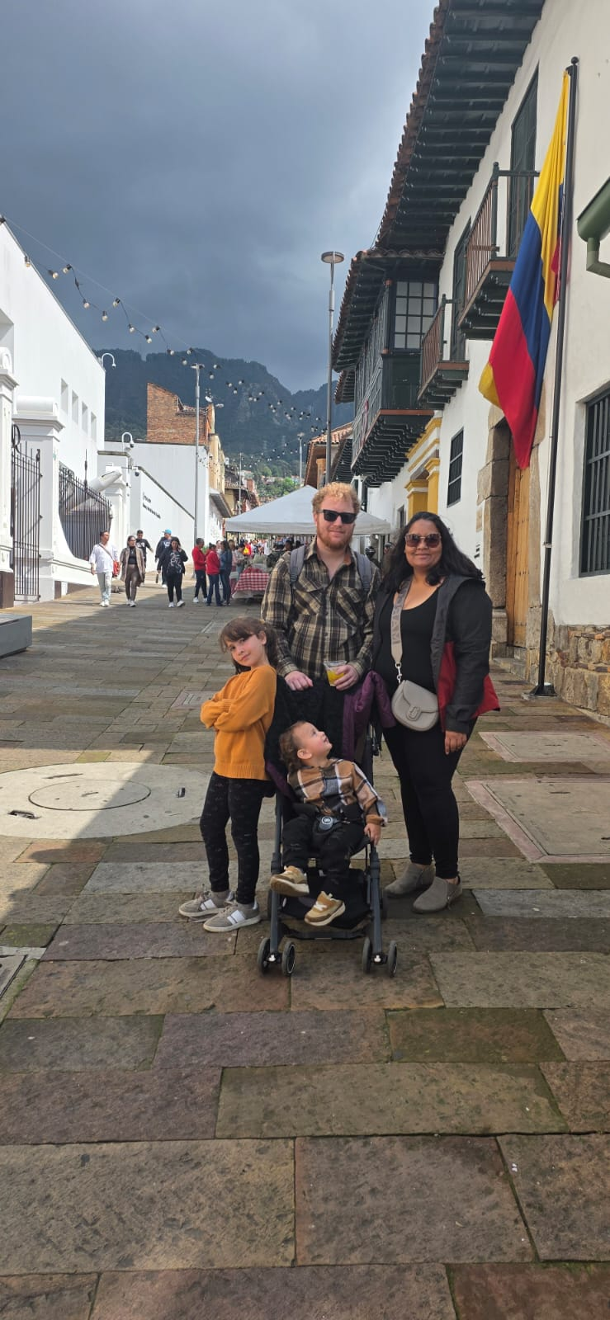
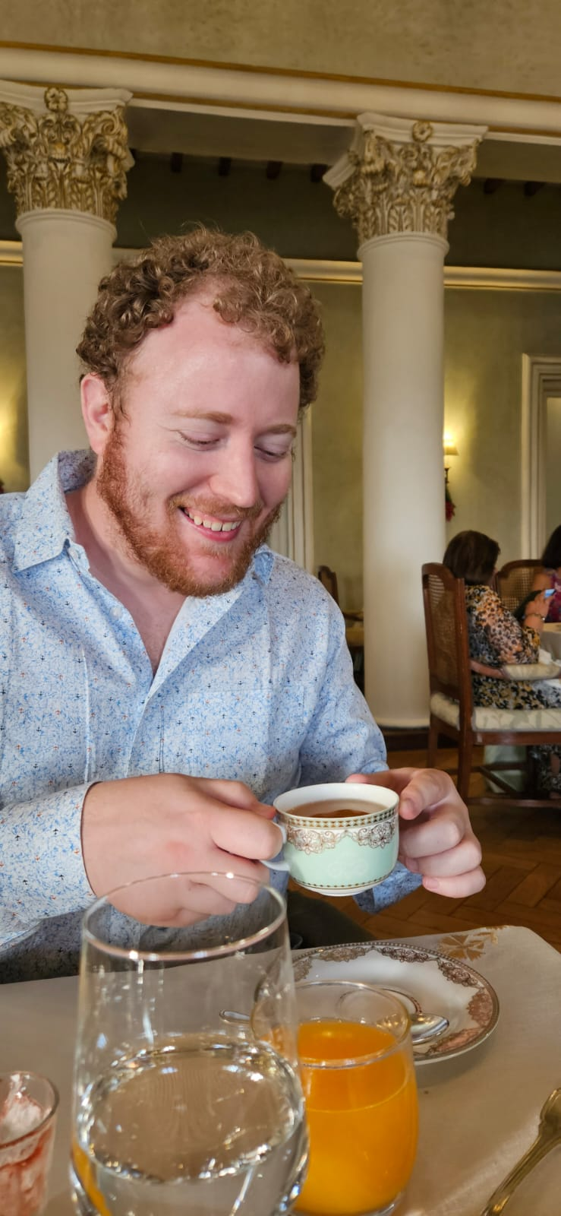
Who am I?
Steven Diamante from Raleigh, NC
Founder of Diamante Technical Coaching
AI Consultant at Artium AI
Avid XP practitioner
pairing
TDD
refactoring
continuous integration
Over 1k hours of Claude Code usage
Building AI with AI in production
Hobbies
Plays guitar and sings
Meditating for over 5 years
Chess and Poker player
Travels the world with family
Notes:
Law of 2 feet

Slide 4
Agenda
What are coding agents?
My AI Coding Journey
Common Failure Modes
Old Habits vs. New Habits
What is Software Craftsmanship?
Demo: Add a new feature to a Stock Tracker App
Taming the Agentic Dragon Workflow

Slide 5
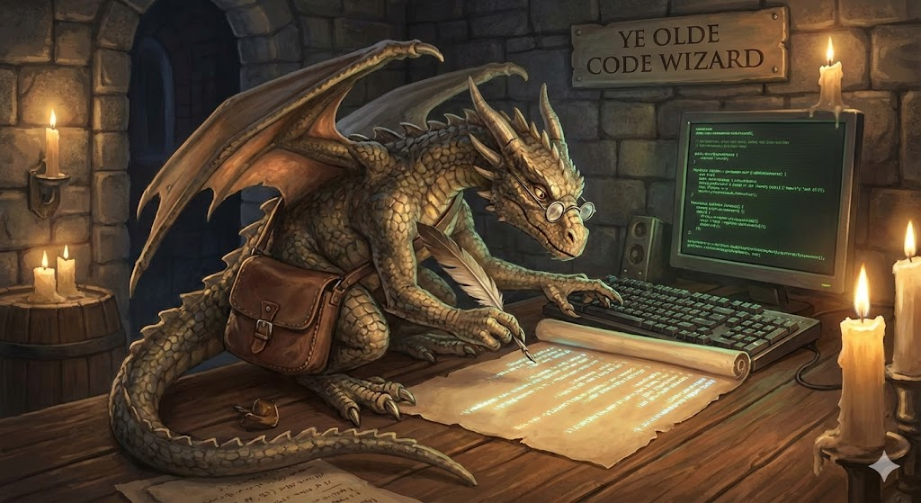
The GenAI Evolution
GPT Copy
Paste
Autocomplete
Coding Agents

Slide 6

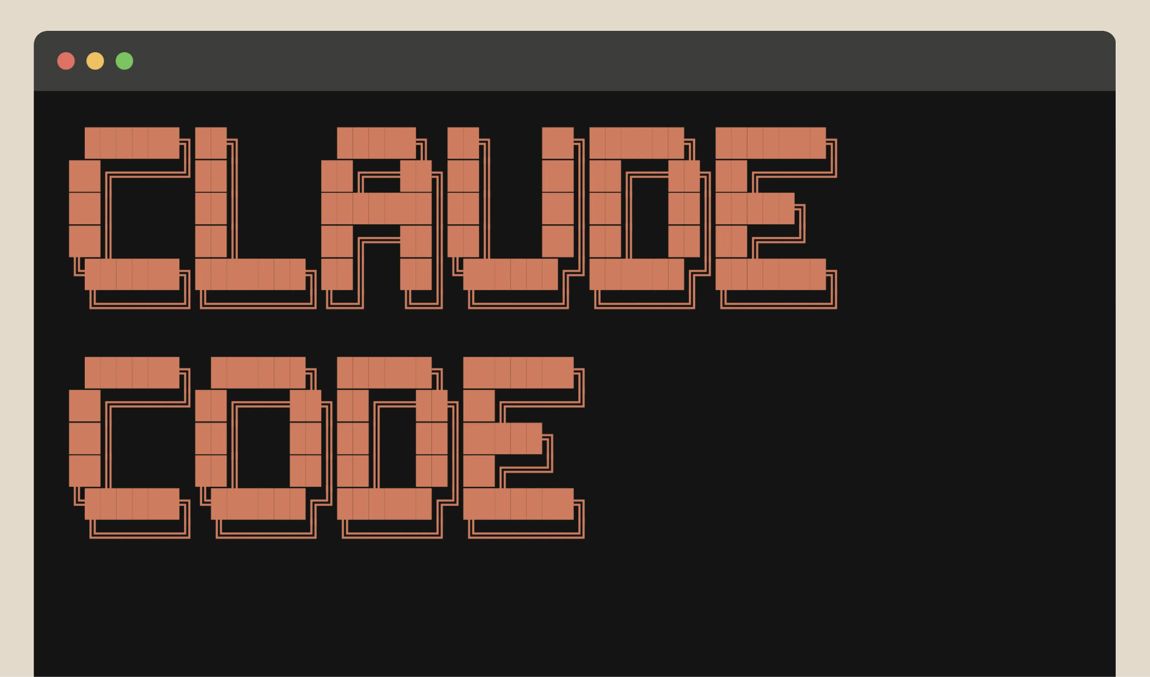

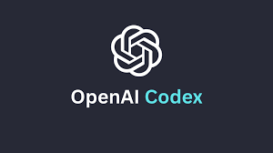

Coding Agents are here!
An agent runs tools in a loop to achieve a goal. Coding agents can read, modify, explore your codebase.
Coding Agents
Notes:
It can:
read your codebase
it can write code in your codebase
it can use bash and UNIX commands
it can do even more than code
it’s much better than asking ChatGPT to code or fancy auto-completion

Slide 7
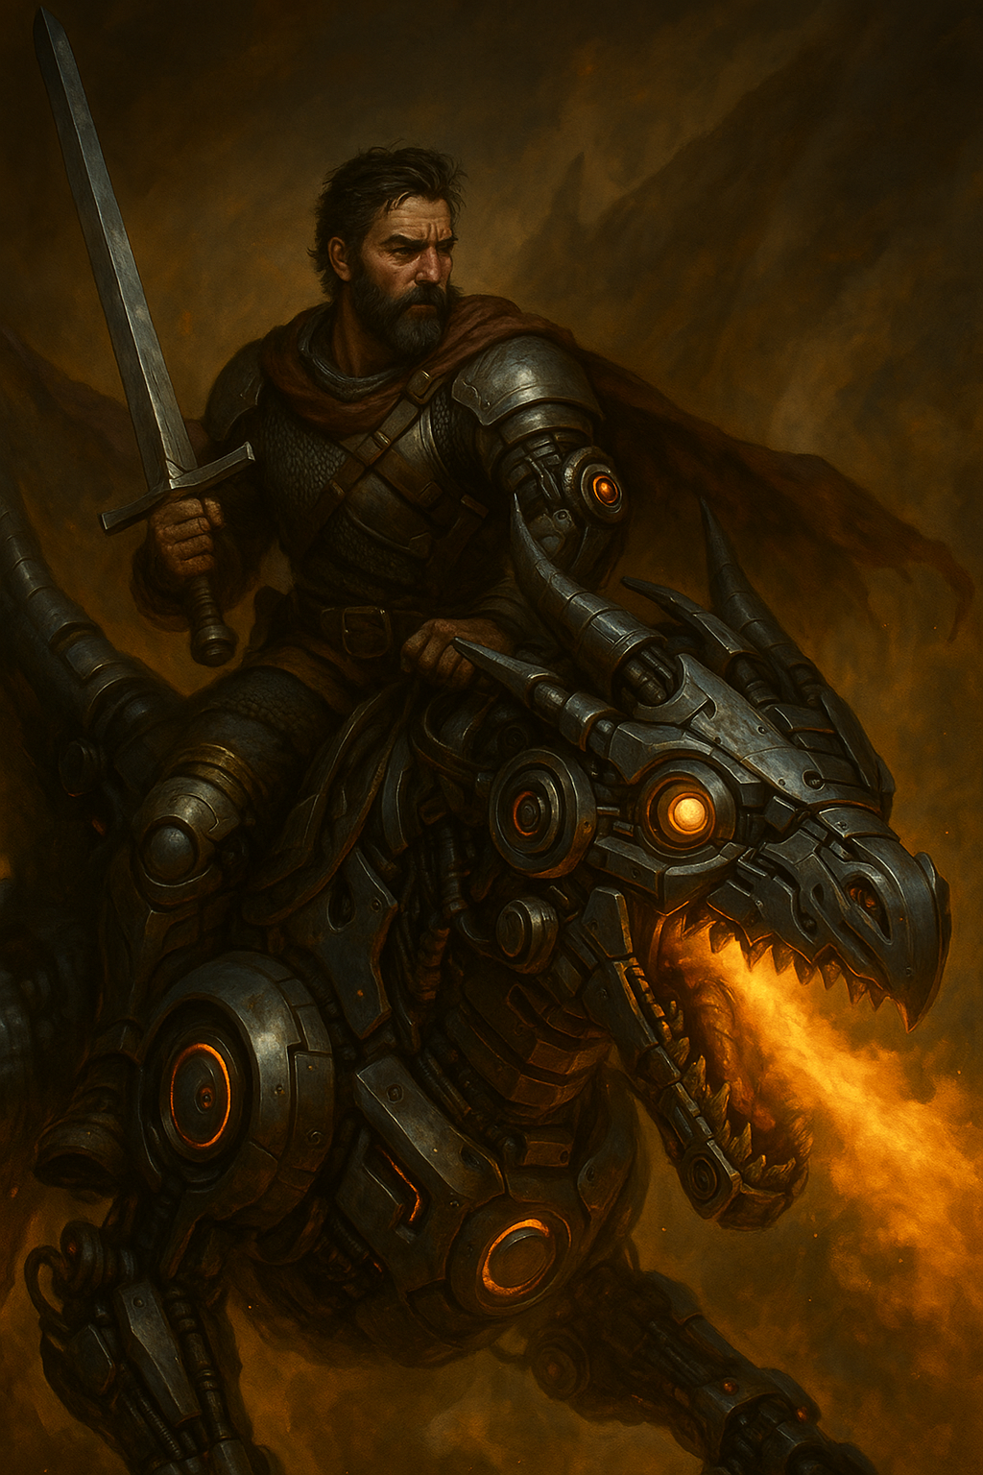
How can we partner with coding agents to deliver high-quality production code at a sustainable pace?

Slide 8
Caveats
90% of production code in TypeScript, 10% in Python
Green field Microservices / micro frontends
Using Claude Code,
but techniques apply to other coding agents
Just sharing, find your own way

Slide 9
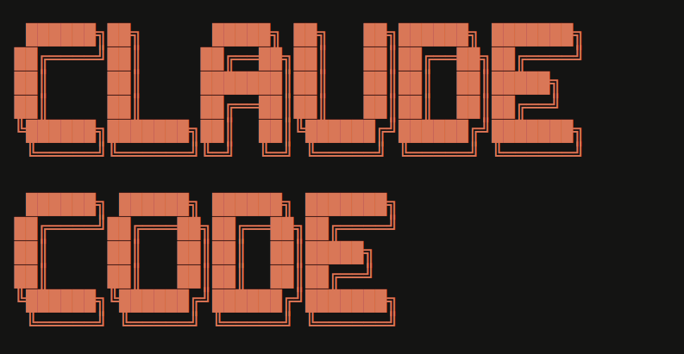

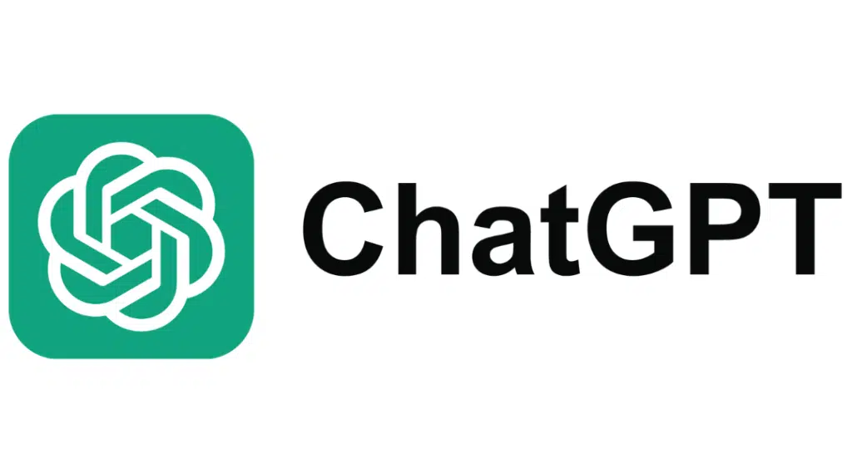

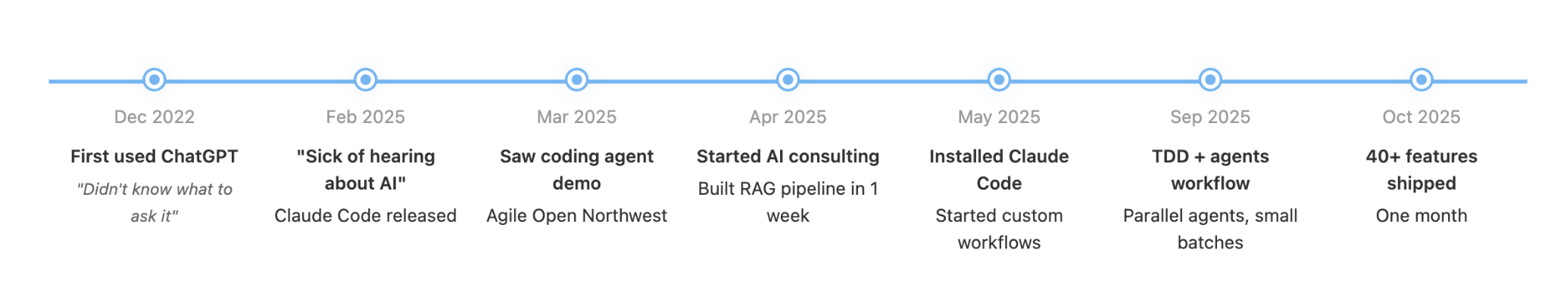
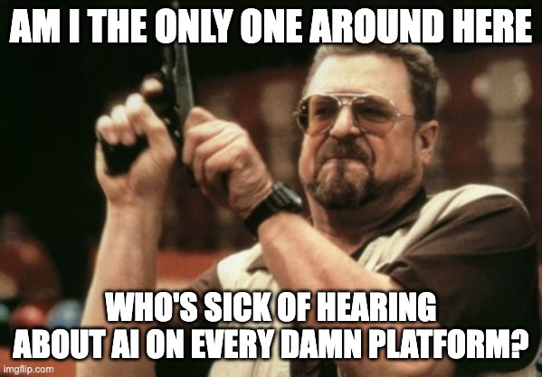

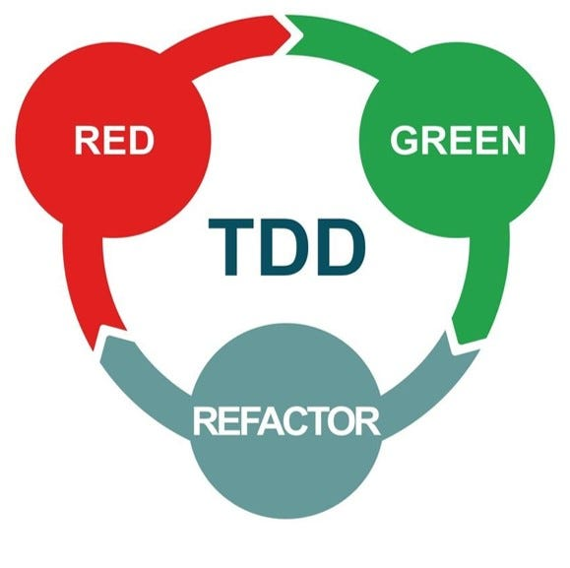
My AI Coding Journey
2018: Started practicing Extreme Programming 2023: Coaching software teams on technical practices

Slide 10

The Death of Coding
Notes:
every other week I loved it and then the next I was sad and missing the old way

Slide 11

Notes:
every other week I loved it and then the next I was sad and missing the old way

Slide 12
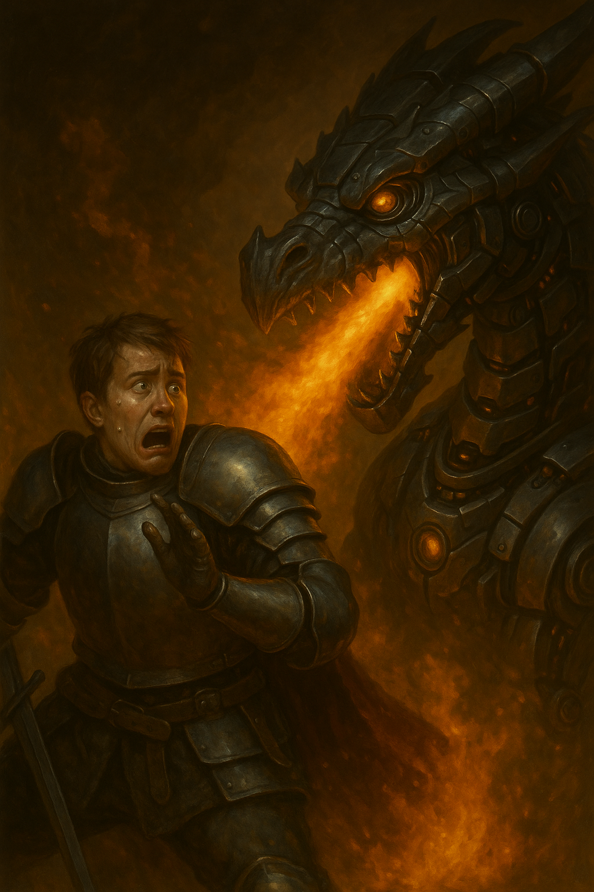
Common AI Coding Failure Modes
for Software Engineers
Notes:
if you’ve tried agents and don’t feel like you’re getting the most out of them,
here are some issues you maxy have had, and some possible solutions

Slide 13

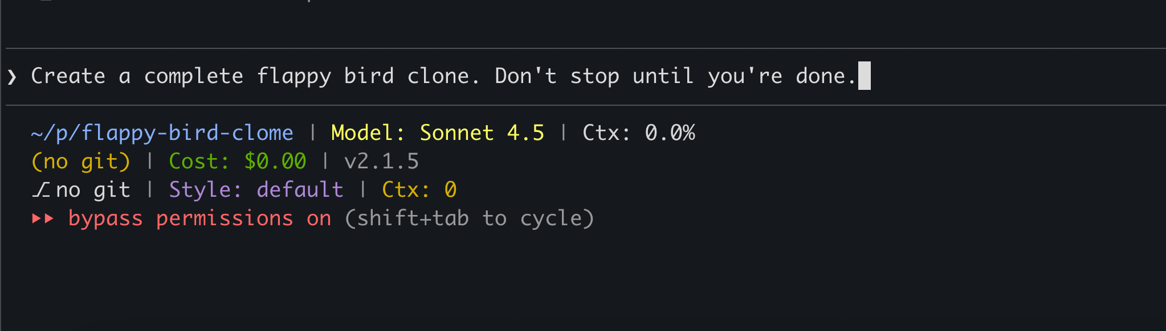
One shot attempts
Failure Modes
Notes:
Artium Day experience

Slide 14

Not respecting the context window
Failure Modes
Notes:
Context Window = White Board (you can only fit a certain amount of writing on)

Slide 15
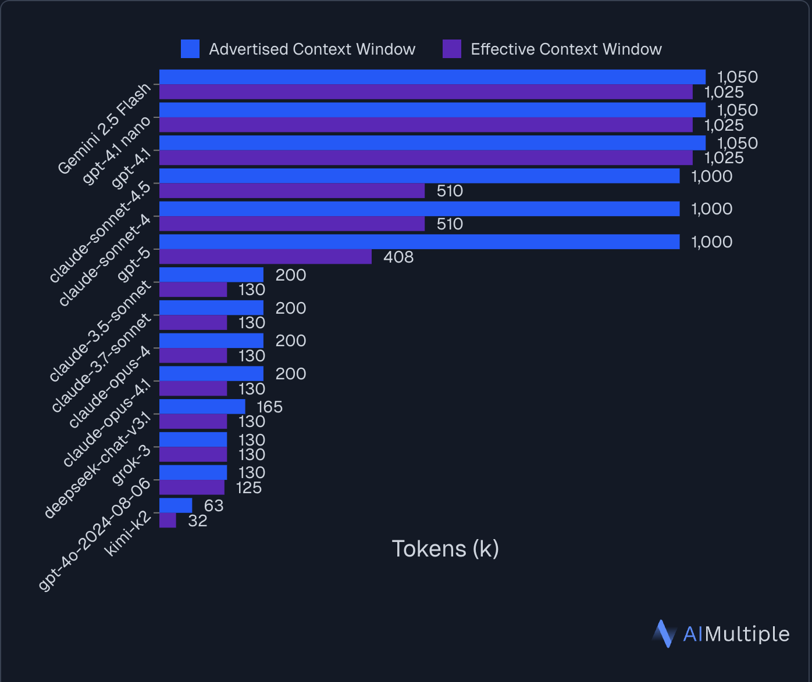
Not respecting the context window
“Most models break much earlier than advertised. A model claiming 200k tokens typically becomes unreliable around 130k, with sudden performance drops rather than gradual degradation.”
— AIMultiple
Failure Modes
Notes:
https://research.aimultiple.com/ai-context-window/

Slide 16

No ground rules
AGENTS.md
CLAUDE.md
.windsurfrules
Failure Modes

Slide 17
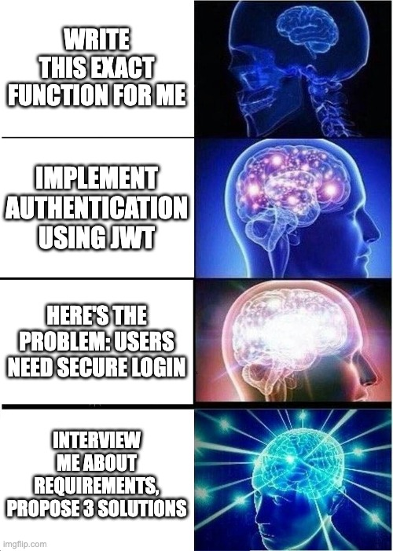
Telling the agent
what to code
Failure Modes
Notes:
Share story about Channelize

Slide 18
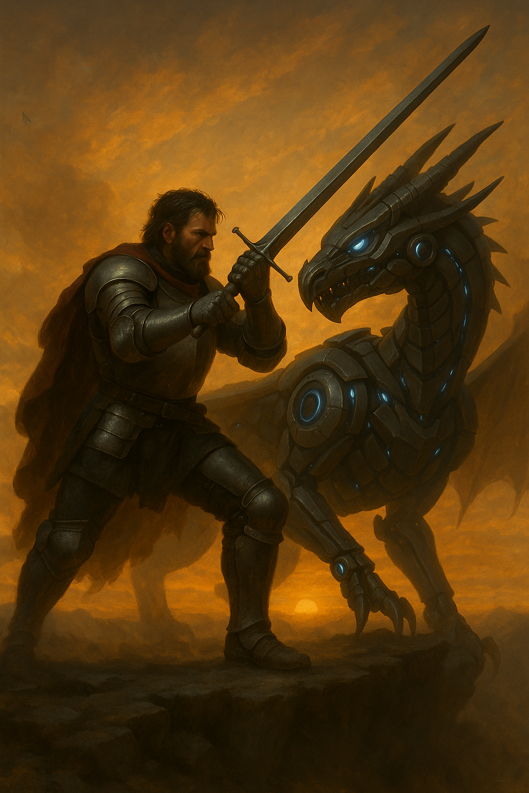
Old Habits
vs.
New Habits

Slide 19
Task Management
OLD HABIT
NEW HABIT
Task lists
Test lists
Behavior-first thinking
Task lists turn into .md files with ASCII wireframes
Behaviors and outcomes thinking still remains

Slide 20
Daily Pairing
OLD HABIT
NEW HABIT
7+ years of pair programming
Strong-style pairing with agents
Communicate intent, not implementation details
Tap into agent’s optionality
Communication
Critique
Honest feedback

Slide 21
Design Evolution
OLD HABIT
NEW HABIT
Evolutionary design
Gradual refinement
Careful iterations
Merciless refactoring
Incremental development with agent collaboration
Rapid iteration cycles with instant feedback
Seek advice of agent’s vast wealth of knowledge

Slide 22
Commit Discipline
OLD HABIT
NEW HABIT
Sometimes microcommits
Occasional rollbacks
Less disciplined
Commit once the code works
Must be able to rollback changes quickly
Agents create messes fast!

Slide 23
Learning & Experimentation
OLD HABIT
NEW HABIT
Careful experimentation
Code attachment
Cautious iterations
Rapid experimentation
Throw away code easily
Keep learnings, ditch implementation

Slide 24
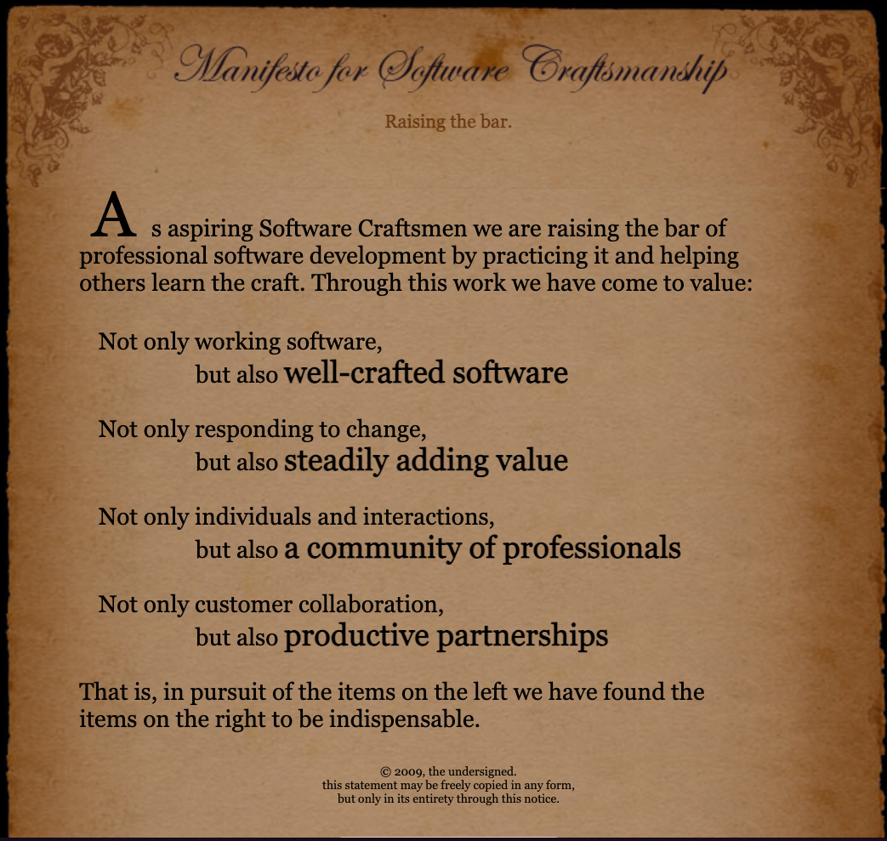
The Craftsmanship Comeback
A movement to prioritize
quality
community
incremental business value
XP practices like
TDD
Continuous Integration (TBD)
Refactoring
Social programming

Slide 25
Stock Tracker App
WHAT IT IS
Modern web platform for real-time stock tracking
Mobile-optimized for retail investors & traders
Unified view of essential stock data
CORE CAPABILITIES
Search & Discover Stocks
Watchlist Management
View interactive candlestick charts
Comprehensive Metrics

Slide 26
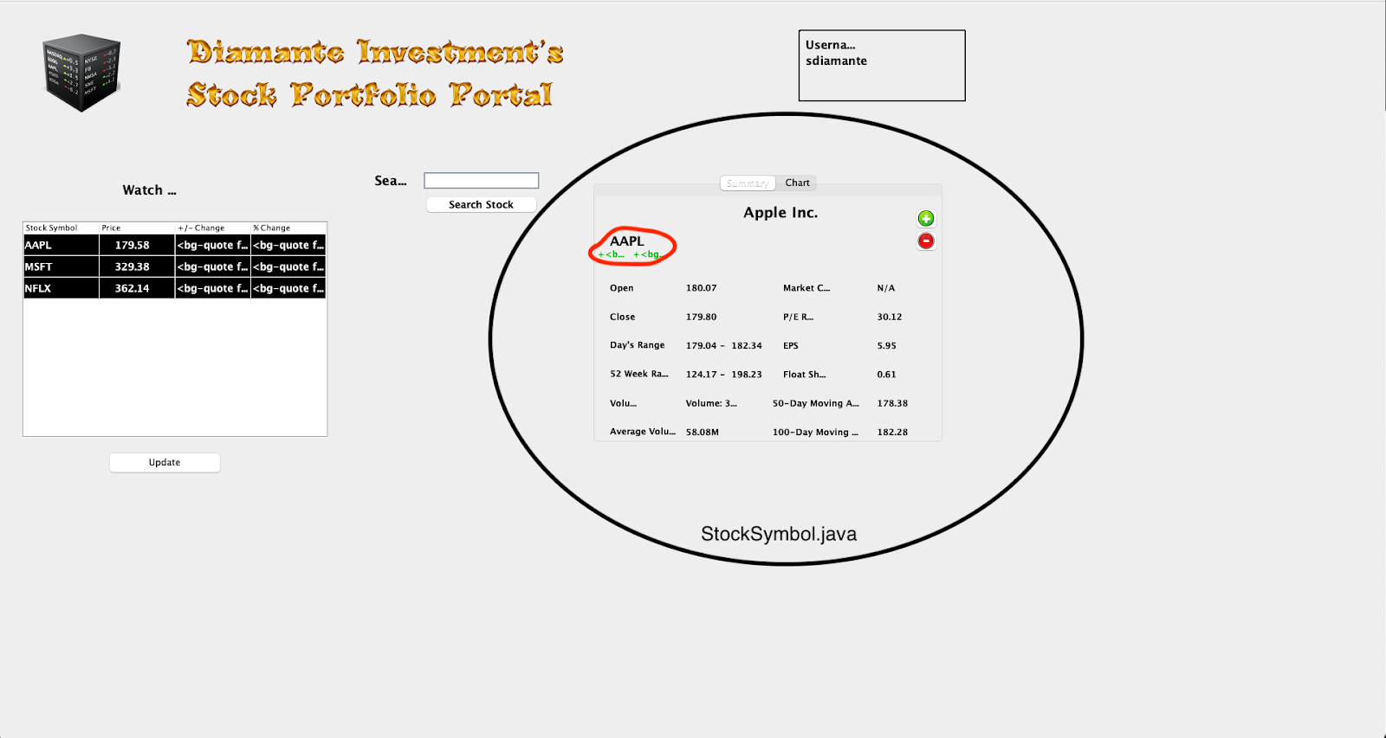
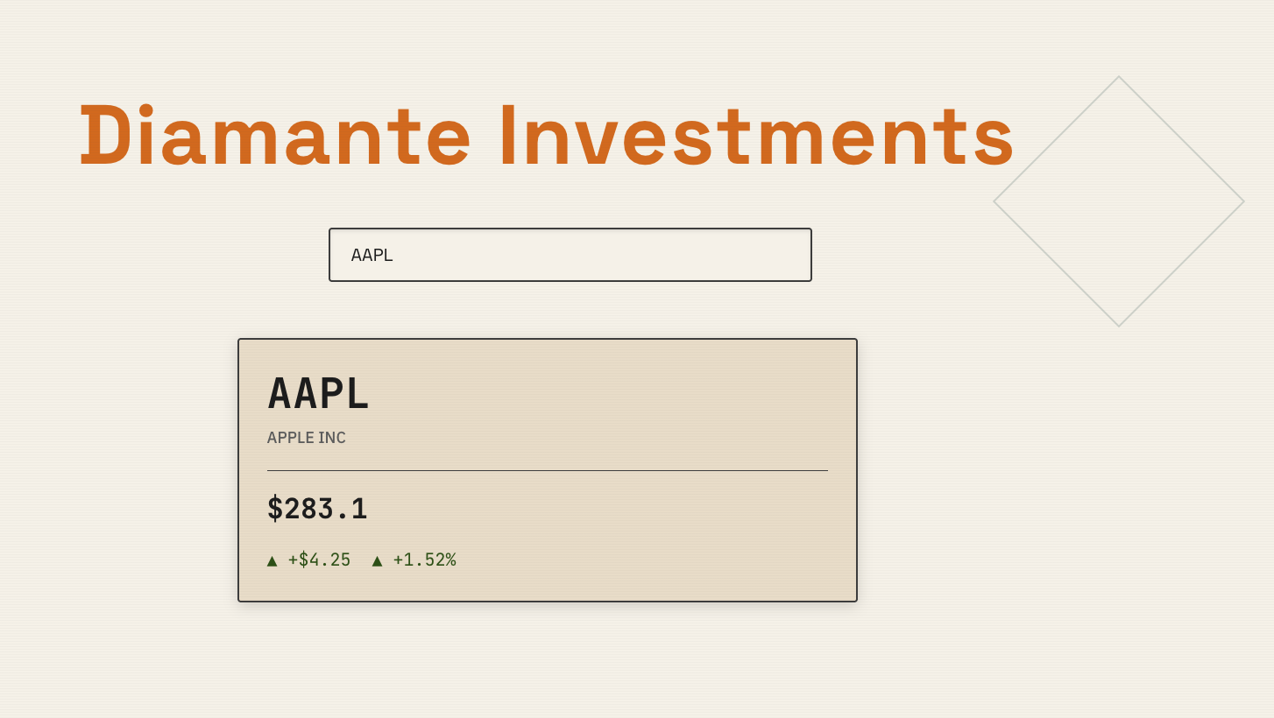
Diamante Investments v1.0 -> v2.0
Java Swing Desktop Application built in 2017
Current Web version

Slide 27

Taming the Agentic Dragon
1. Ground Rules
5. Agent & Human
Final Review
2. Planning
3. Context Window
Management
4. Predictive TDD

Slide 28
Taming the Agentic Dragon
1. Ground Rules
5. Agent & Human
Final Review
2. Planning
3. Context Window
Management
4. Predictive TDD

Slide 29
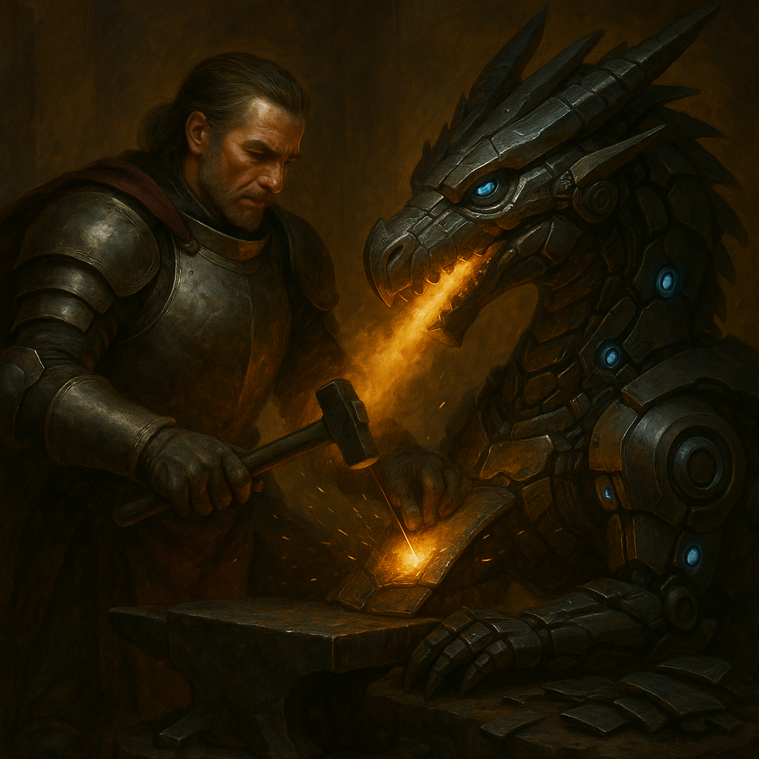
Ground Rules
Don’t repeat yourself in every chat
Give your agent rules and guidelines to follow
CLAUDE.md, AGENTS.md files
Working agreement with agent
Ask agent to help create rules
When working with an agent's defaults, they may not suit your needs. As you find yourself teaching and lecturing the agent, make a note to put down rules.

Slide 30
Taming the Agentic Dragon
1. Ground Rules
5. Agent & Human
Final Review
2. Planning
3. Context Window
Management
4. Predictive TDD

Slide 31
Define Success Before You Code
📋
🎯
Gherkin User Stories
Given/When/Then scenarios
Clear acceptance criteria
Expected Outcomes
What success looks like
Measurable results

Slide 32
Provide Context
🤔
📃
Integration Information
Why are we doing this?
What problem does it solve?
Business value alignment
API documentation
System diagrams
Existing code patterns

Slide 33
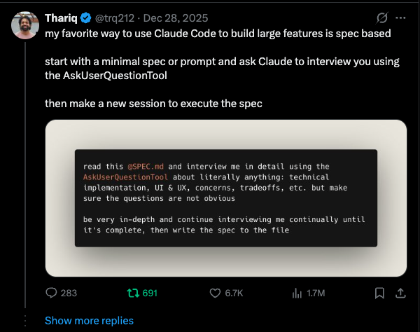
❓
Ask Clarifying Questions
Interview Mode
Let agent probe for details
Uncover edge cases
3️⃣
Give Me 3 Options
Different implementation approaches
Trade-off analysis
📐
For UI: Ask for ASCII Wireframes
Visual layout planning before implementation

Slide 34
Review & Refine
⚠️ WARNING: Read Every Line
🐛
There's something wrong in the plan
🔧
Find it and correct it
❓
Challenge assumptions
✅
Verify completeness
🦾
Have another agent review the plan

Slide 35
Taming the Agentic Dragon
1. Ground Rules
5. Agent & Human
Final Review
2. Planning
3. Context Window
Management
4. Predictive TDD

Slide 36
Context Window Management
Plan ready? Check your context window!
Models degrade at ~60% of context window
Extract plan to .md file?
Continue with execution in same session?
OR

Slide 37
Taming the Agentic Dragon
1. Ground Rules
5. Agent & Human
Final Review
2. Planning
3. Context Window
Management
4. Predictive TDD

Slide 38
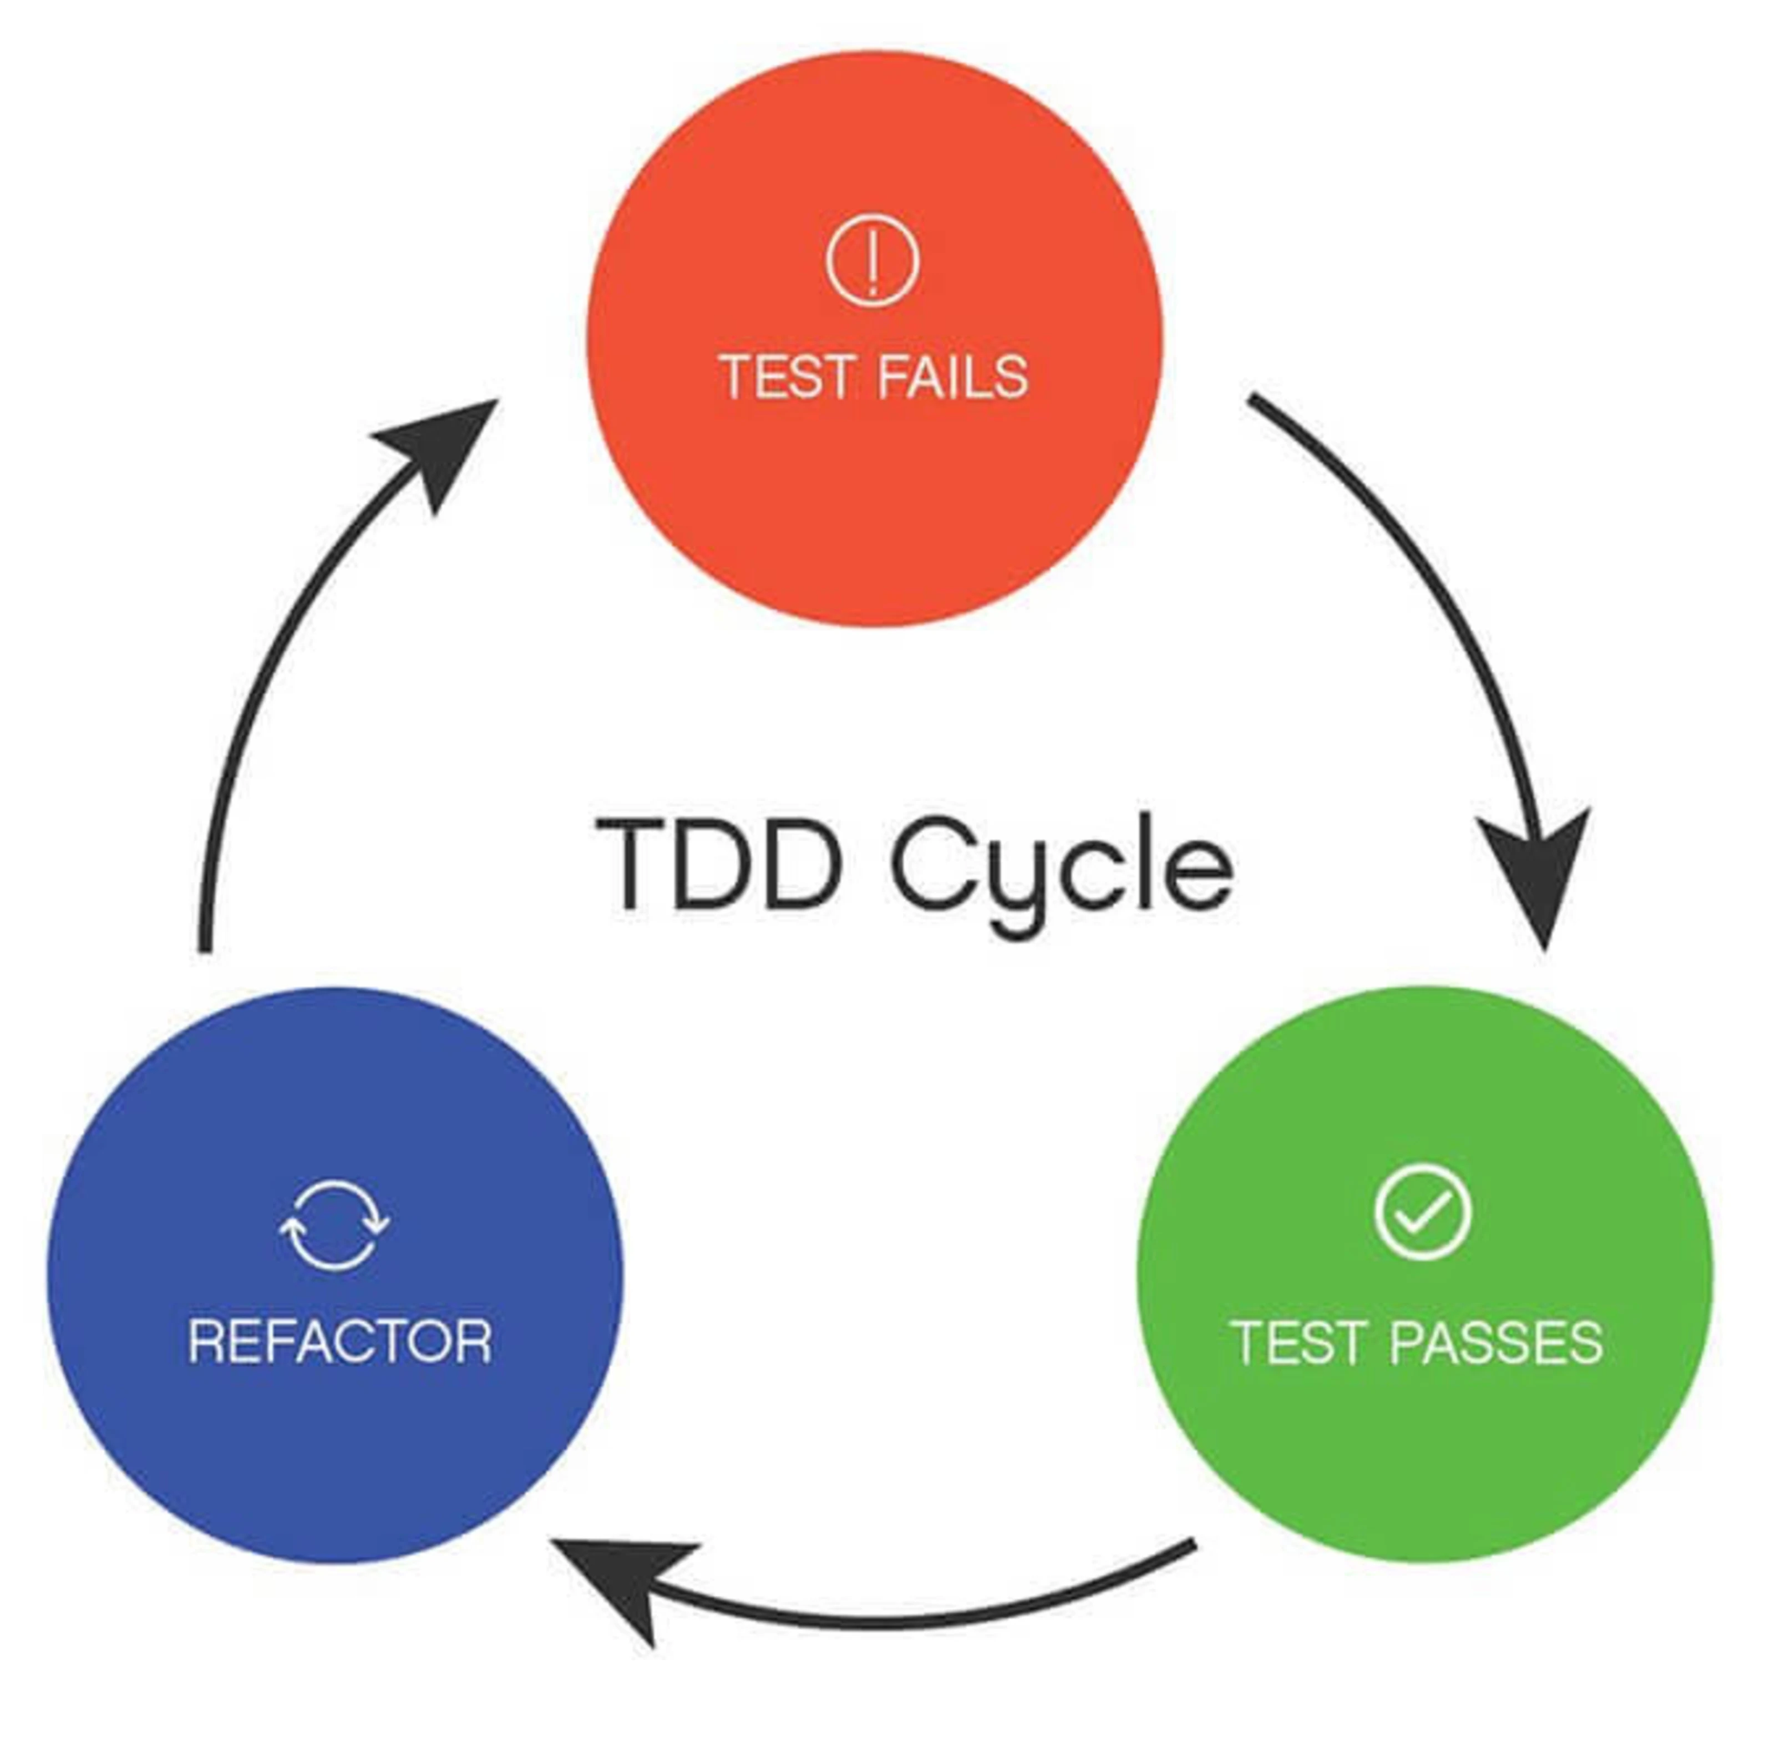
Predictive TDD
Ted M. Young (@JitterTed)
Use custom TDD slash command
Test behaviors, not implementation
Keep mocking minimal
Prefer acceptance tests with test containers & mock servers
Tight feedback loop for agent to self-correct

Slide 39
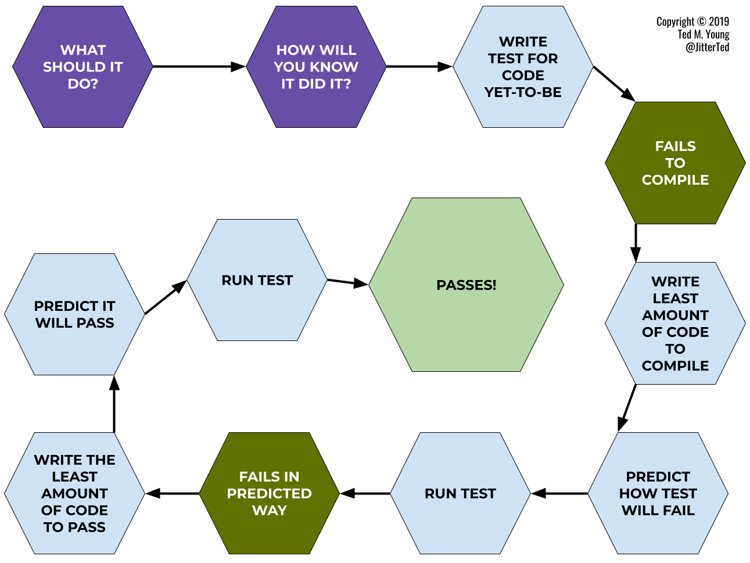
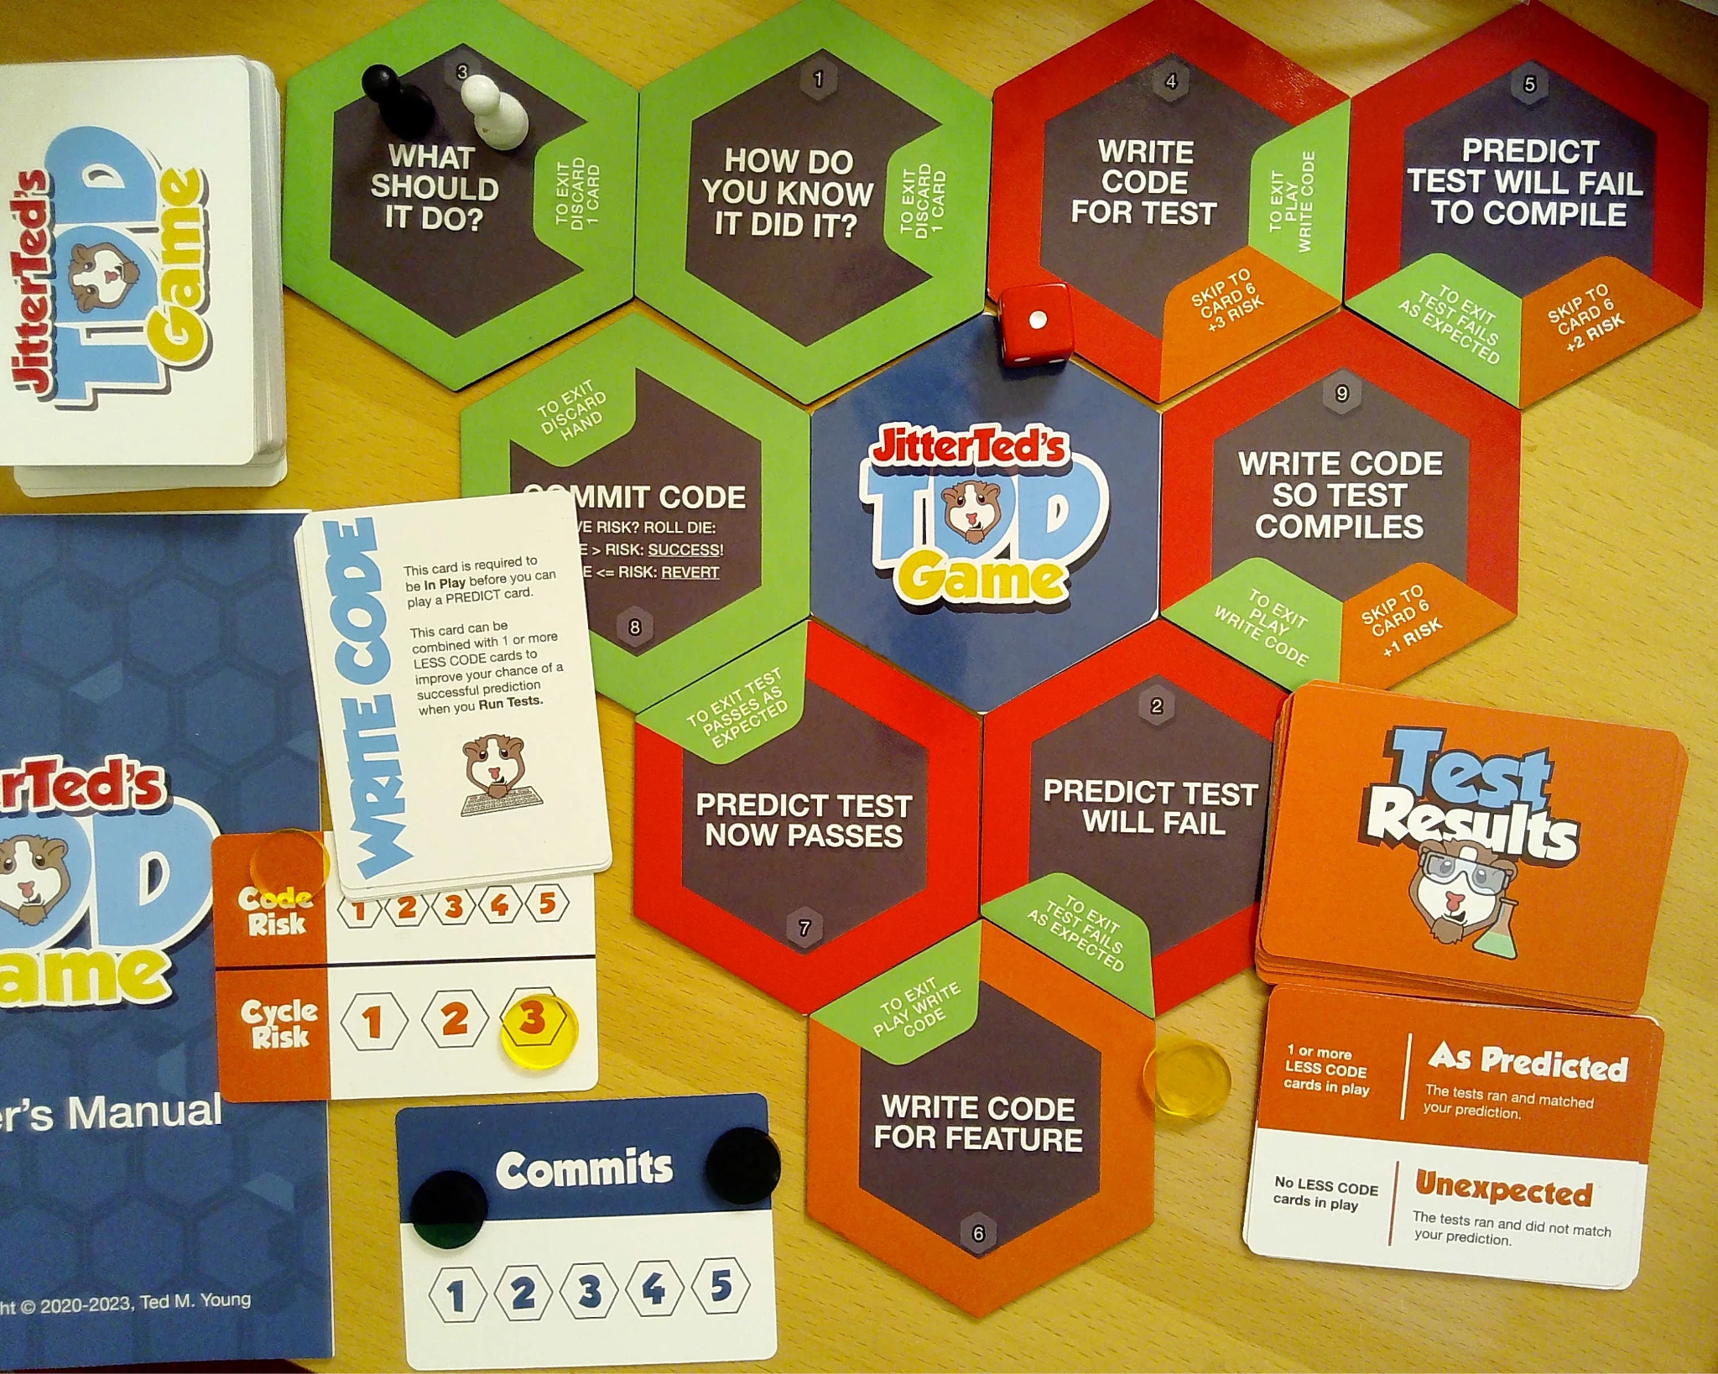
Predictive TDD
Ted M. Young (@JitterTed)

Slide 40
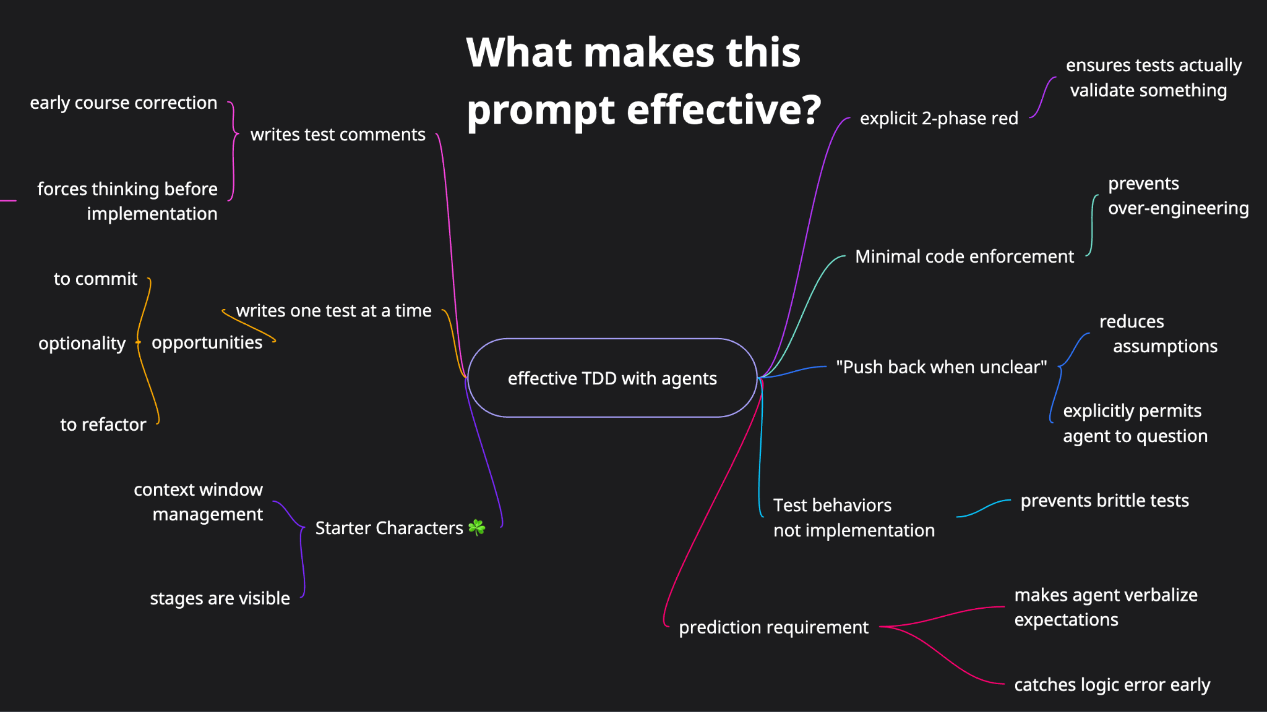

Slide 41
How to Enforce Refactoring Step
Git hooks + strict linting rules
precommit => build & format & lint
prepush => run all tests
💡 Commit with additional coding agent to save unnecessary context

Slide 42
Taming the Agentic Dragon
1. Ground Rules
5. Agent & Human
Final Review
2. Planning
3. Context Window
Management
4. Predictive TDD

Slide 43
Agent & Human Final Review
🧪
🎭
Manual Testing
Playwright MCP
UI testing by agent
Automated exploratory testing
Verify functionality works as expected
👁️
👤
Fresh Agent Review
Human Final Review
Code review with criteria
Unbiased perspective
Human oversight
Refactor as needed

Slide 44
Taming the Agentic Dragon
Remember
“I'm about to clear this conversation. Compile a list of the 5 most important things that would be useful to add to the CLAUDE.md. Tell me first for approval”
1. Ground Rules
5. Agent & Human
Final Review
2. Planning
3. Context Window
Management
4. Predictive TDD

Slide 45

Takeaways
Create ground rules, stop repeating yourself
Plan first: Use interview mode, get 3 options, verify with ASCII wireframes
Watch your context window - extract plans at ~60%
Use Predictive TDD to catch errors early and enable self-correction
Multi-layer review: manual testing → agent review → human oversight
Experiment and find what works for you

Slide 46
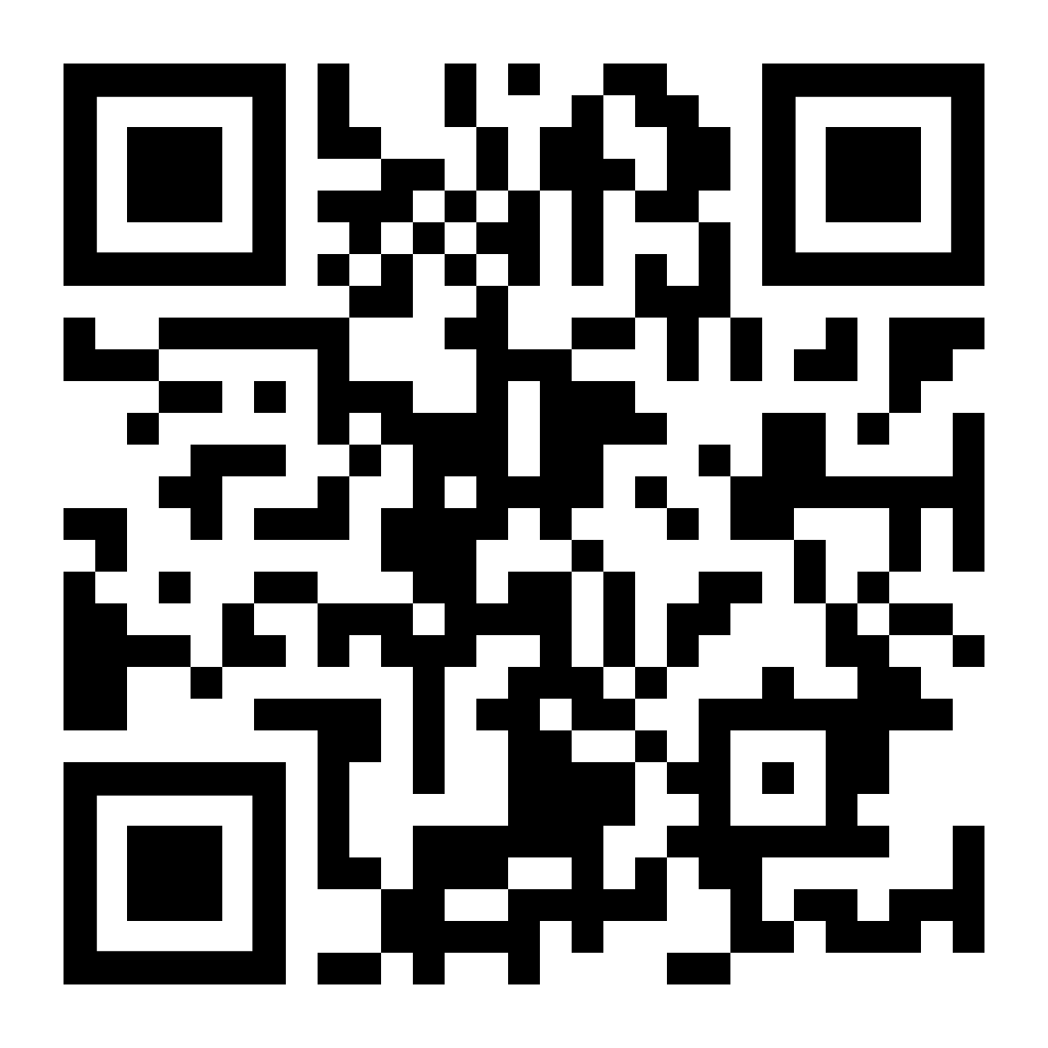
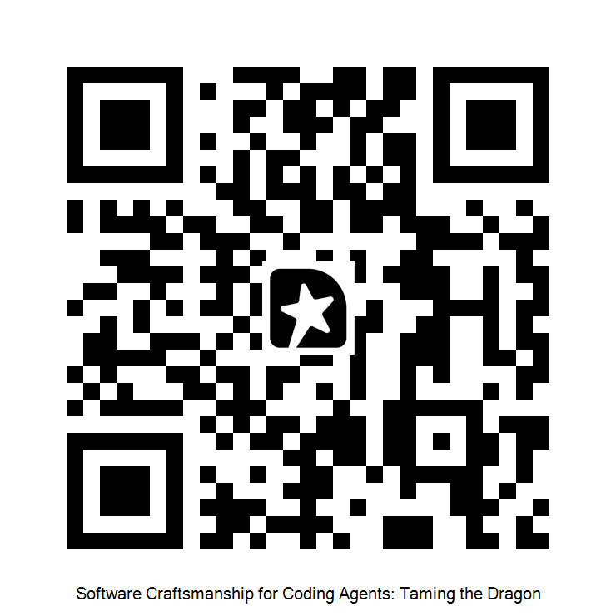
Tame your Dragon Today!
Get the Resources
& Let's Connect
🔗 Connect on LinkedIn
👨🏼‍💻 Diamante Technical Coaching
💻 Slides from this talk
🦾 Claude Code Skills & Agents
📧 AI Coding Newsletter
📅 Book a session
Feedback?
Notes:
https://calendly.com/diamantetechcoaching https://github.com/SDiamante13/dotfiles/tree/main/claude

